Slide 1

MGM’S POLYTECHNIC, AURANGABAD. Mechanical Department
Capstone project Title
3D PRINTER
by
Veersing Pardeshi 32112
Mohammed saad 32115
Arvind gaikwad 32108
Raees ather ali 32219
Under the Guidance Of
Prof. Shingare R.P.

Slide 2
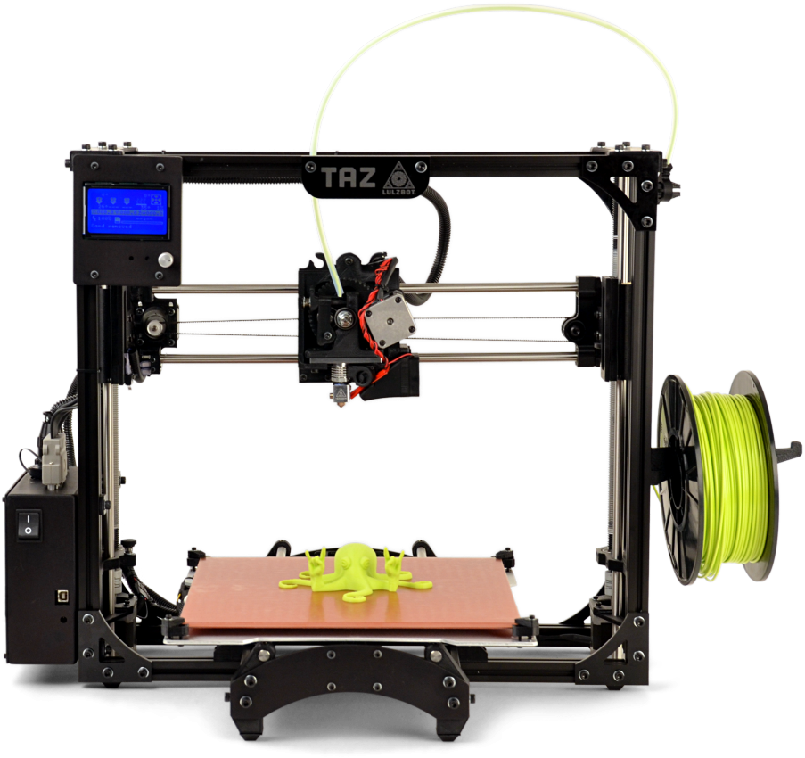
3D PRINTER
MENTOR : PROF. SHINGARE R.P.

Slide 3
ABSTRACT
3D Printing technology, also known as Additive Manufacturing (AM), refers to processes used to generate a 3D object in which layers of material are successively formed under a computer controlled program to create a physical object. The 3D file source is usually sliced into several layers, each layer generating a set of computer controlled instructions. The significances of this technology, such as the ability to construct complex geometric structures matched to patient’s anatomy or surgeon’s requirement, enable its wide applications in medicine, ranging from surgical planning tools to custom surgical devices.

Slide 4
CONTENT
ABSTRACT
COSTING OF PARTS
INFORMATION OF PARTS
PROJECT DIAGRAM
APPLICATION
FUTURE PLANS
PROBLEM
SOFTWARE
INTRODUCTION

Slide 5
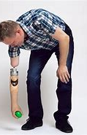
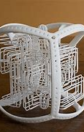
PROBLEM
COMPLEX OBJECT
MEDICAL PROBLEM

Slide 6
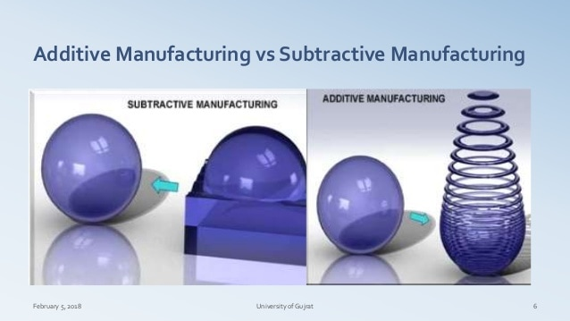
PROBLEM
TIME
WASTE OF MATERIAL

Slide 7
WHY WE ARE MAKING 3D PRINTER
For understanding the concept of 3d printing for the future scope
For checking the design that we have make is correct or not
To make the real model of that are in our mind
For explaining the details of 3d printing concept
For college use

Slide 8
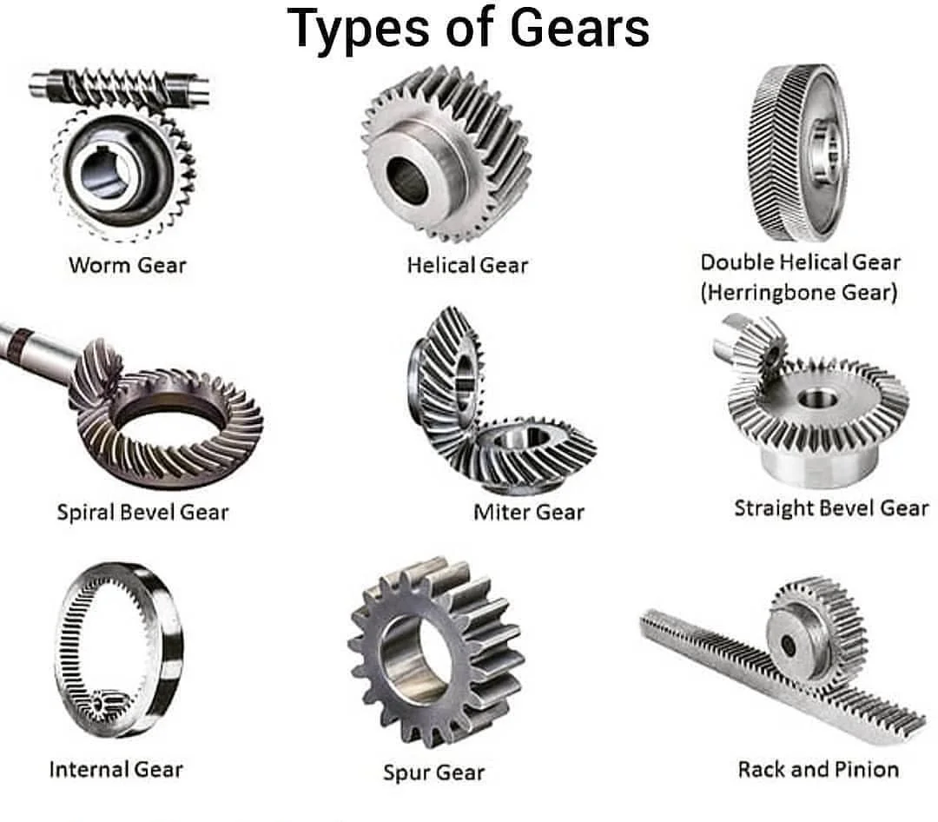
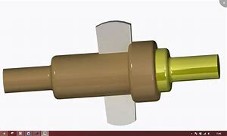

Slide 9
INTRODUCTION
What is 3D Printing?
3D printing or additive manufacturing is a process of making three dimensional solid objects from a digital file.
The creation of a 3D printed object is achieved using additive processes. In an additive process an object is created by laying down successive layers of material until the object is created. Each of these layers can be seen as a thinly sliced cross-section of the object.

Slide 10


SOFTWARE FOR 3D PRINTING
Marlin (firmware)
Marlin is open source firmware primarily designed for RepRap project based FDM (fused deposition modelling) 3D-printers using the Arduino platform.

Slide 11
1.Costing of products
SR NO. | PRODUCT NAME | QUANTATY | PRICE
1 | Arduino Mega+RAMPS 1.4 Shield+4 x A49AA Stepper Driver | 1 | 1500
2 | Nema 17 Stepper motor | 4 | 3000
3 | Endstops | 4 | 300
4 | E3D Hotend | 1 | 450
5 | 240watt Power Supply- | 1 | 1000
6 | LCD Display(optional | 1 | 200
7 | MK8 Extruder | 1 | 250
8 | SC8UU Bearings(Replacement for LM8UU Bearings) | 2 | 100

Slide 12
SRNO. | PRODUCT NAME | QUANTITY | PRICE
9 | Stepper Motor Mount | 5 | 100
10 | M3 Screws | 10 | 50
11 | M3 NUTS | 10 | 20
12 | 3mm Acrylic sheet | 30X30 cm | 600
13 | Aluminum Channel for Frame | 200 CM | 1000
14 | HeatBed | 1 | 600
15 | 2 x 5mmx8mm Couplers | 2 | 250
16 | GT2 Timing Belt | 1 | 250
17 | 2 x Lead Screw + Flange Nu | 2 | 500
18 | TOTAL COSTING |  | 13000 rs

Slide 13
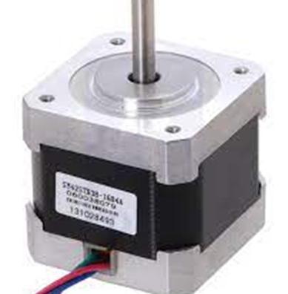
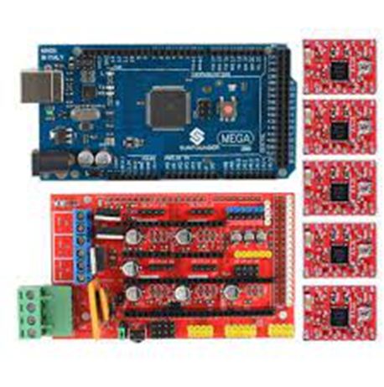
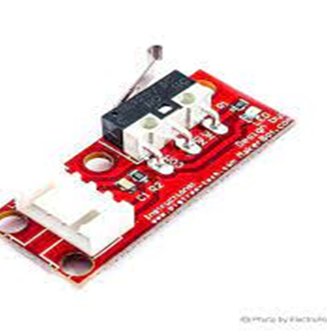
1) Nema 17 Stepper motor
2) Ramps 1.4 + A4988 + Arduino Mega
3) Endstops

Slide 14
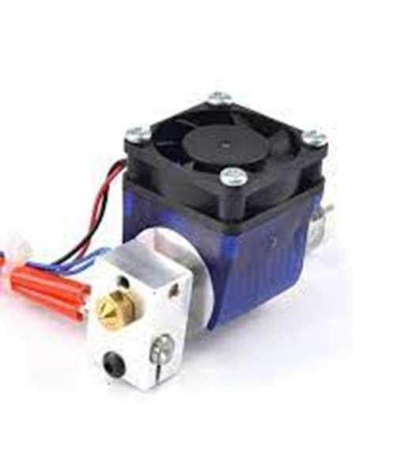
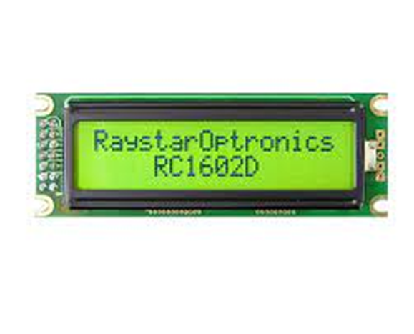
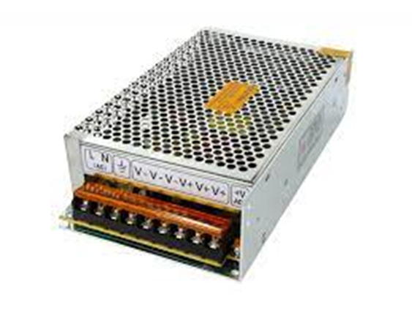
4) E3D Hotend
5) 240watt Power Supply
6) LCD Display

Slide 15
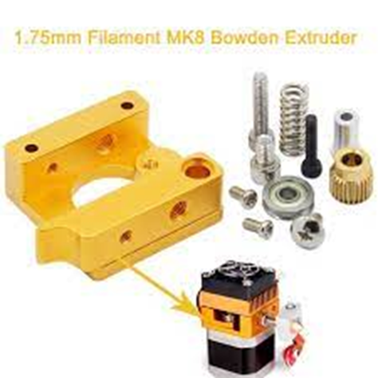
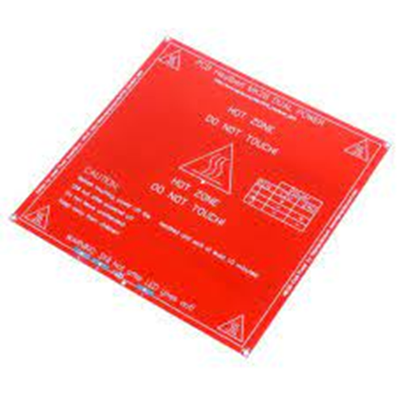
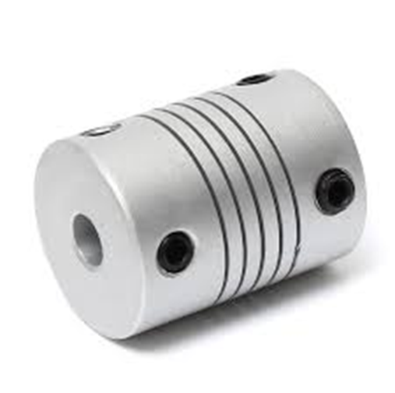
7) MK8 Extruder
8) HeatBed
9) 2 x 5mmx8mm Couplers

Slide 16
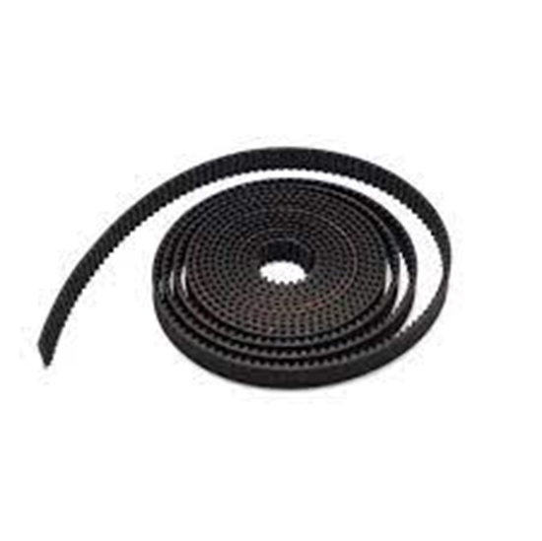
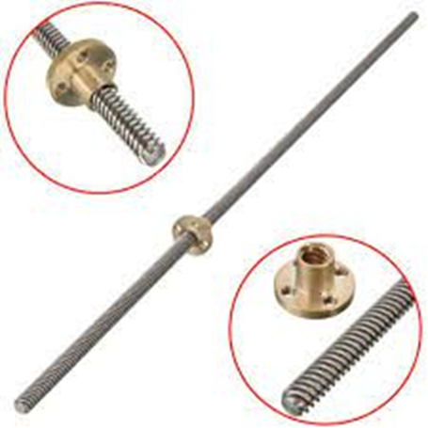
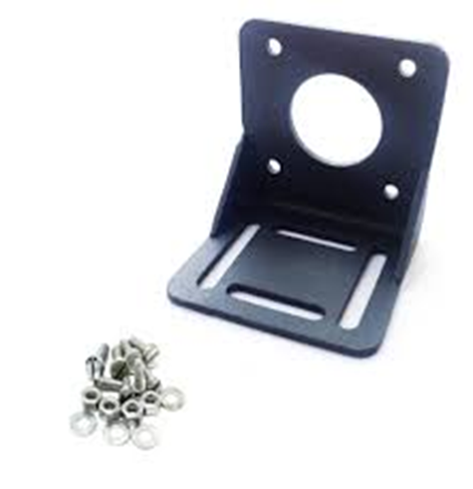
10) GT2 Timing Belt
11) 2 x Lead Screw + Flange Nut
12) Stepper Motor Mount

Slide 17
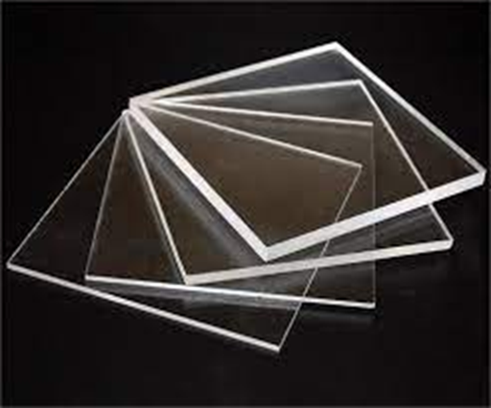
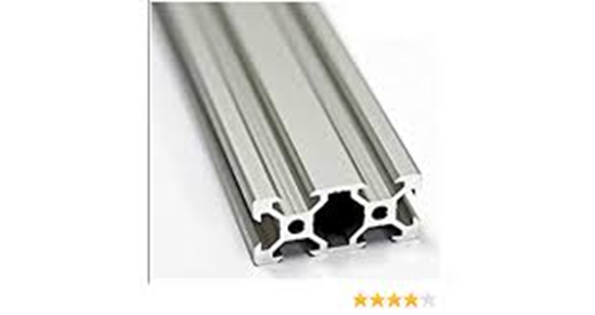
13) 3mm Acrylic sheet
14) Aluminum Channel for Frame

Slide 18
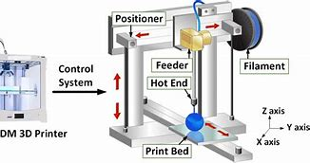
Project diagram

Slide 19
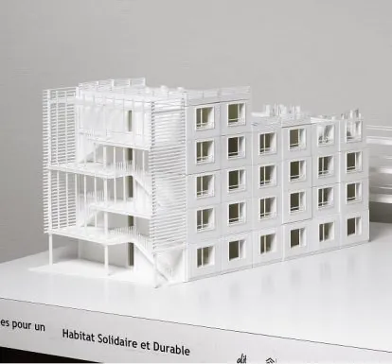
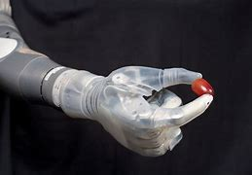
APPLICATION OF 3D PRINTING
Healthcare and Medical
Architecture and Construction

Slide 20
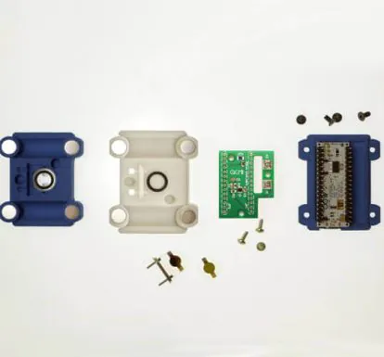
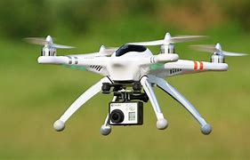
Electronics
Drones

Slide 21
Future plan assembly
•Buying of product
•Assembly of parts
•Connection of parts
•Programing of Arduino
•3D model of object
•Convert to STL file format
•Printing of final product

Slide 22

THANK YOU
ANY QUESTIONS

